Slide 1
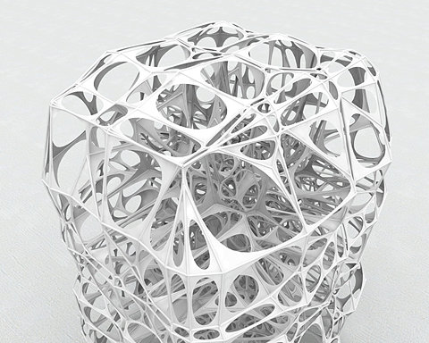
Grids For Designing Spaces and Objects
These are both grids!

Slide 2
Space Planning Basics

Slide 6
Barcelona Pavilion The grid controls where elements will be placed.

Slide 7
Farnsworth House

Slide 9
The grid assists in designing

Slide 13
A grid may be ‘deformed’ for some purpose or effect.

Slide 14
Piet Mondrian de Stijl artist

Slide 15
Prostho Museum Research Center in Japan designed by Kengo Kuma, 2010

Slide 16
A geodesic dome

Slide 17
A Frank Lloyd Wright ‘Usonian’ house plan

